Slide 1
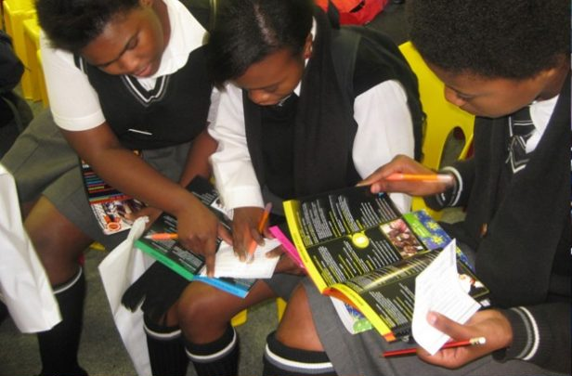
STEP INTO YOUR FUTURE
#CAREER EXPO, BANKUNA HIGH SCHOOL
08 -09 May 2024
(Wednesday & Thursday)
#CAREER EXPO
Bankuna High School Hall, Nkowankowa Township
@ 09:00
Join us for a Matriculants Career Expo
Date : 08-09 May 2024
Time : 09:00
Venue : Bankuna High School Hall,
Nkowankowa Township

